Slide 1
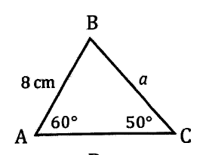
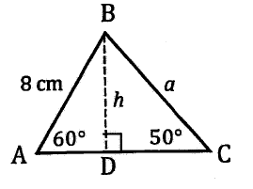

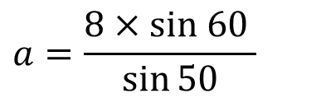
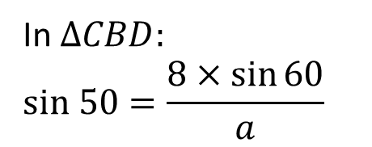

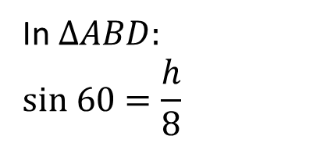
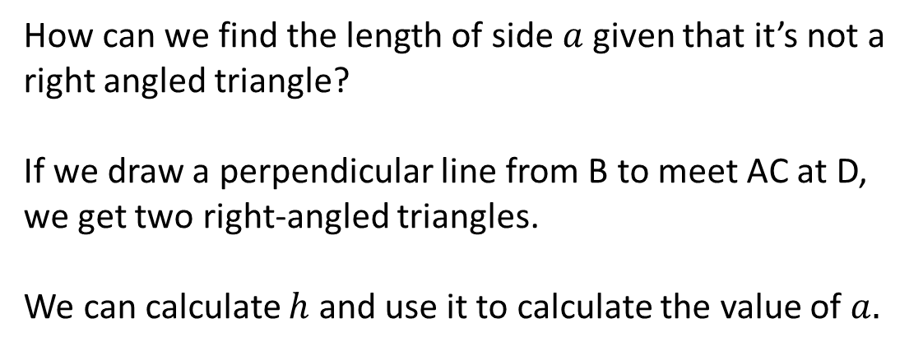

The sine rule
How can we find the length of side $a$ given that it’s not a right angled triangle?
If we draw a perpendicular line from B to meet AC at D, we get two right-angled triangles.
We can calculate $h$ and use it to calculate the value of $a.$
In $∆ABD:$
$$sin 60=\frac{h}{8}$$
In $∆CBD:$
$$sin 50=\frac{8×\sin{60}}{a}$$
$$h=8×sin 60$$
$$a=\frac{8×sin 60 }{\sin{50}}$$
$$a≈9.04$$
We can apply this to a general triangle ABC to gain the sine rule:

Slide 2
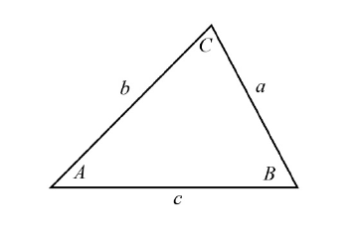
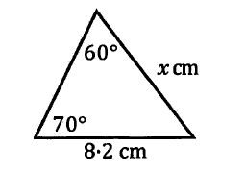
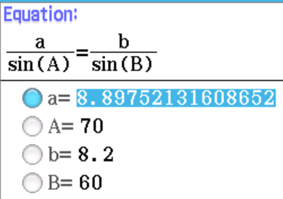
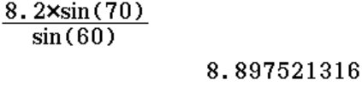
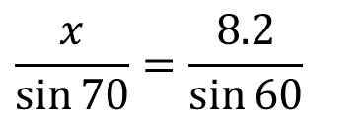


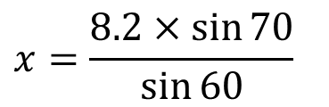
Examples
Any side on the sine of the opposite angle is equal to any other side on the sine of its opposite angle.
Calculate $x$
$$\frac{x}{\sin{70}}=\frac{8.2}{\sin{60}}$$
Can also use sine rule on E-activity:
$$x=\frac{8.2×\sin{70}}{\sin{60}}$$
$x=8.9 cm$(to 1 dp)

Slide 3
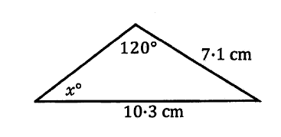
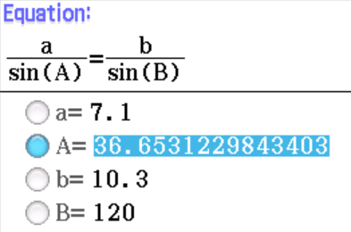
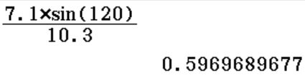


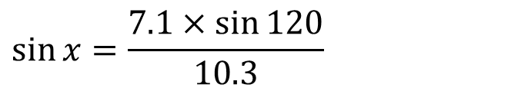
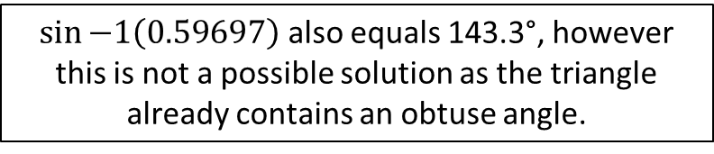
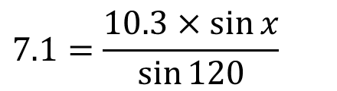

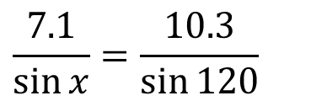

Examples
Any side on the sine of the opposite angle is equal to any other side on the sine of its opposite angle.
Calculate $x$
$$\frac{7.1}{\sin{x}}=\frac{10.3}{\sin{120}}$$
Can also use sine rule on E-activity:
$$7.1=\frac{10.3×\sin{x}}{\sin{120}}$$
$$7.1×\sin{120}=10.3×\sin{x}$$
$$\sin{x}=\frac{7.1×\sin{120}}{10.3}$$
$\sin{−1\left(0.59697\right)}$ also equals 143.3°, however this is not a possible solution as the triangle already contains an obtuse angle.
$$x≈36.7°$$

Slide 4
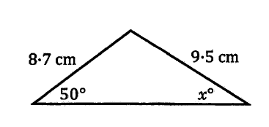
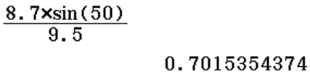
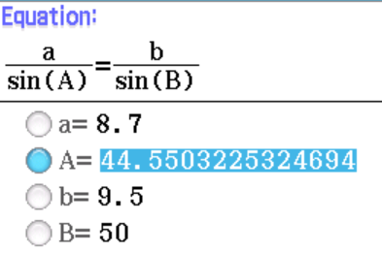

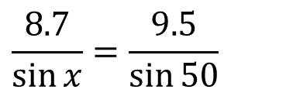

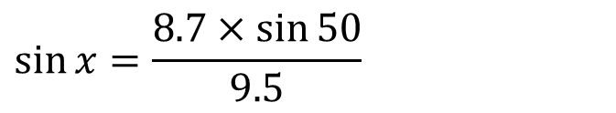
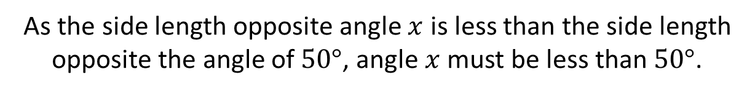


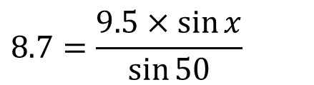
Examples
Any side on the sine of the opposite angle is equal to any other side on the sine of its opposite angle.
Calculate $x$
As the side length opposite angle $x$ is less than the side length opposite the angle of $50°$, angle $x$ must be less than $50°$.
Can also use sine rule on E-activity:
$$\frac{8.7}{\sin{x}}=\frac{9.5}{\sin{50}}$$
$$8.7=\frac{9.5×\sin{x}}{\sin{50}}$$
$$x≈44.6°$$
$$8.7×\sin{50}=9.5×\sin{x}$$
$$\sin{x}=\frac{8.7×\sin{50}}{9.5}$$

Slide 5
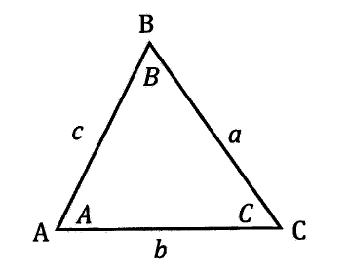
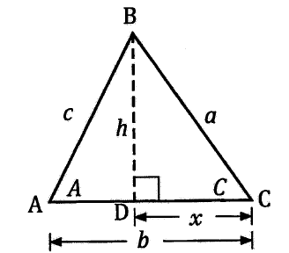







The cosine rule
From $∆CBD: a^{2}=h^{2}+x^{2}$
From $∆ABD: c^{2}=h^{2}+{(b−x)}^{2}$
$$c^{2}=h^{2}+(b−x)(b−x)$$
$$c^{2}=h^{2}+b^{2}+x^{2}−2bx$$
From $∆CBD: \cos{C=\frac{x}{a} ∴} x=a\cos{C}$
$$c^{2}=a^{2}+b^{2}−2ba\cos{C}$$
This is the cosine rule.
Or $c^{2}=a^{2}+b^{2}−2ab\cos{C}$
Or $b^{2}=a^{2}+c^{2}−2ac\cos{B}$

Slide 6
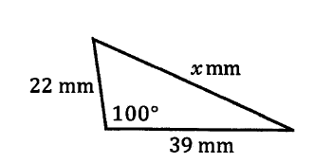
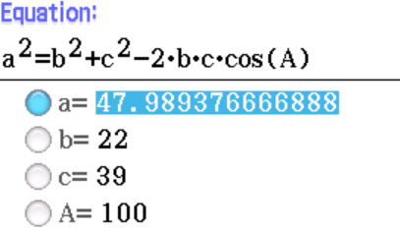

Examples
The square of any side of a triangle is equal to the sum of the squares of the other two sides take away twice the product of the other two sides multiplied by the cosine of the angle between them.
Calculate $x$
$$x^{2}={22}^{2}+{39}^{2}−2×22×39×\cos{100}$$
$$x^{2}=2302.980273$$
Can also use cosine rule on E-activity:
$$x=47.9894..$$
$$x≈48$$

Slide 7
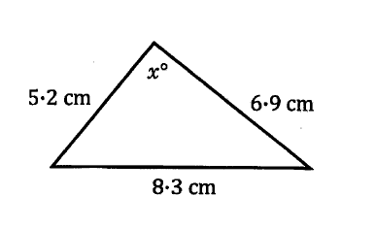
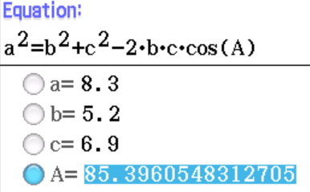

Examples
The square of any side of a triangle is equal to the sum of the squares of the other two sides take away twice the product of the other two sides multiplied by the cosine of the angle between them.
Calculate $x$
$${8.3}^{2}={5.2}^{2}+{6.9}^{2}−2×5.2×6.9×\cos{x}$$
$${8.3}^{2}−{5.2}^{2}−{6.9}^{2}=−2×5.2×6.9×\cos{x}$$
$$\cos{x=}\frac{{8.3}^{2}−{5.2}^{2}−{6.9}^{2}}{−2×5.2×6.9}$$
Can also use cosine rule on E-activity:
$$\cos{x=}0.0803$$
$$x=85.3961$$
$$x≈85.4$$

Slide 8
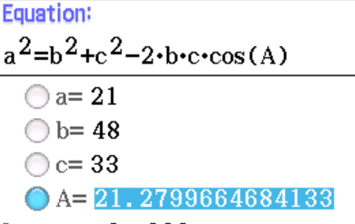
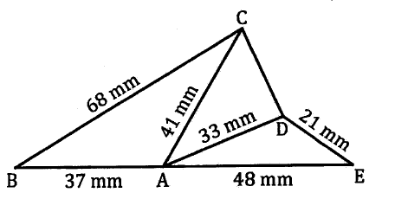
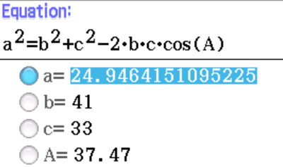
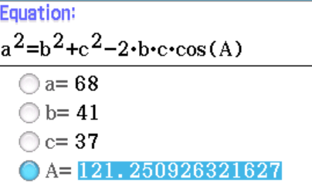




Examples
Now do exercise 11C
$${21}^{2}={48}^{2}+{33}^{2}−2×48×33×\cos{<DAE}$$
Calculate CD
$$<DAE=21.280$$
$<CAD=180− <BAC− <DAE$ = 37.47
$${68}^{2}={41}^{2}+{37}^{2}−2×41×37×\cos{<BAC}$$
$$CD=24.9 mm$$
$$<BAC=121.251$$

